Slide 1


NeuroStore — India’s Sovereign Cloud
Decentralized, S3-compatible storage that leverages idle capacity across Tier‑2 / Tier‑3 Indian data centers to undercut hyperscalers by ~80% while meeting data-localization and compliance needs.
Vision: Make compliant, enterprise-grade cloud storage affordable across India — priced in INR, built for Indian infrastructure realities.

Slide 2

The Problem — The Indian Data Tax
Hyperscaler pricing: AWS/GCP/Azure impose an effective "data tax" (bandwidth + egress + storage tiering).
Data-localization pressure: DPDP & enterprise compliance demand on‑shore storage and residency assurances.
Centralized risk: Large single-cloud outages, geopolitical exposure, and vendor lock-in threaten availability and sovereignty.
Customer Impact
Market Gap
MSMEs and enterprises pay premium prices or compromise on compliance—drives shadow IT and fragmented backups.
No scalable, local, cost‑efficient S3-compatible alternative designed for Indian tiered supply.
CEO's Speaking Notes: Frame hyperscalers as expensive and misaligned to India’s legal and price-sensitive segments. Stress urgency from DPDP timelines and recurring outage headlines.

Slide 3
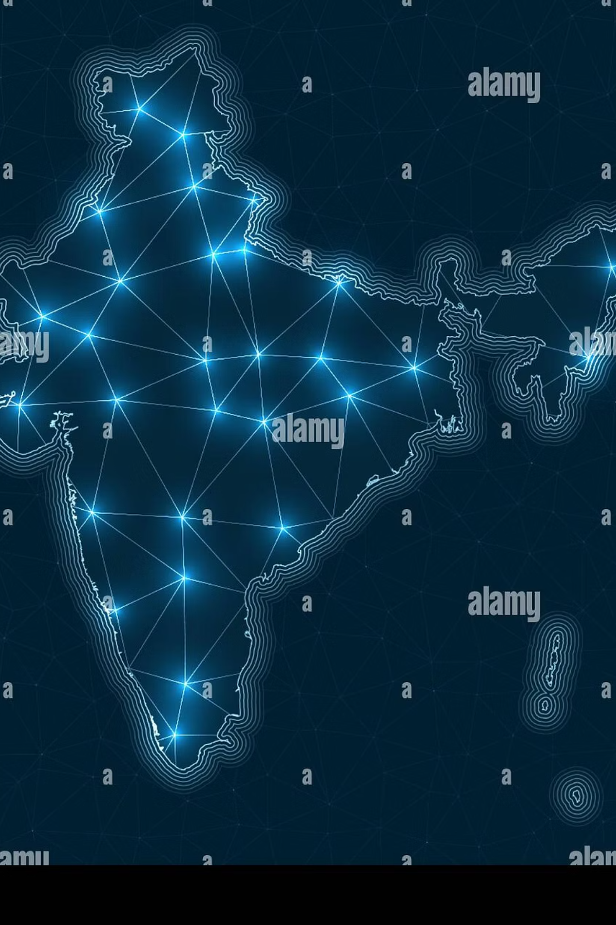
The Solution — Decentralized Edge Storage
Edge-first, S3-compatible Gateway: plug-and-play for existing apps (one line of config)
Zero‑Knowledge crypto: providers never see plaintext; privacy by design for compliance
Resilient architecture: Erasure coding + multi‑node replication for 100% effective uptime SLA
Pricing: target ~20% of AWS S3 (same semantics, huge TCO win)
CEO's Speaking Notes: Present NeuroStore as the intersection of sovereignty, cost, and availability. Emphasize that customers keep S3 semantics — no app rewrites.

Slide 4

How It Works — Core Tech
AES‑256‑GCM client-side encryption: end-to-end confidentiality and tamper evidence.
Reed‑Solomon (10+5) erasure coding: each object split into 15 shards — any 10 shards reconstruct data.
LibP2P Kademlia swarm: peer discovery, peer routing, and efficient shard retrieval across the mesh.
CEO's Speaking Notes: Give the quick math: 15 shards per object → tolerate up to 5 simultaneous node failures with automatic repair. Highlight that encryption keys never leave the client.

Slide 5


Strategic Advantage — The India Play
Supply-side arbitrage
Rent low-utilization racks in Tier‑2/Tier‑3 colocation centers at deep discounts vs. metro pricing.
Local compliance
Nodes physically in India satisfy DPDP residency and reduce cross-border risk for regulated customers.
Operational SLA
Geographically dispersed nodes + erasure coding deliver high effective availability at low cost.
CEO's Speaking Notes: Explain how we convert idle capacity into predictable, high‑margin supply, and why Indian colocation operators welcome monetization of underused racks.

Slide 6


The Wedge Product — S3‑Compatible Gateway
Drop‑in S3 gateway: preserves REST semantics, IAM integration, and metadata behavior.
Minimal migration: "one line of config change" for most workloads → immediate cost savings.
Go‑to‑market focus: Cold storage verticals — CCTV, compliance logs, backup archives.
CCTV / Video Archives
Logs & Audits
High-volume, write-once read-rarely data — perfect for low-cost, high-durability cold tiers.
Regulatory retention (months–years) at a fraction of hyperscaler cost.
CEO's Speaking Notes: Emphasize go‑to‑market simplicity — target system integrators and CCTV vendors first, then expand to backups and archives.

Slide 7
Business Model — Unit Economics (INR)
Metric
Example / Assumption
Wholesale rack rent (monthly)
₹40,000 per rack (Tier‑2 market)
Effective storage cost per GB
₹0.02 / GB / month (after amortization)
Target customer price
₹0.10 / GB / month (≈20% of AWS)
Gross margin
~80% on storage unit economics
CEO's Speaking Notes: Walk investors through the arbitrage: idle-disk economics → attractive gross margins even after operations, repair, and SLA insurance layers. Show path to profitability once supply anchors scale.

Slide 8

Market Opportunity — Why Now
India MSME & enterprise storage demand: billions of GBs from CCTV, healthcare, edtech, fintech, and gov records.
Data‑localization tailwind: DPDP and sectoral rules drive on‑shore spend — estimated >$20B shift across cloud categories.
Pricing-sensitive segments: MSMEs cannot afford hyperscaler TCO; they prioritize predictable INR pricing.
CEO's Speaking Notes: Quantify TAM/TAM expansion by showing how each CCTV installation or MSP contract converts to long-lived ARR. Stress stickiness of archive workloads.

Slide 9

Growth Strategy — Supply & Demand Flywheel
Supply anchor: Partner with local ISPs and colo operators to secure racks and on‑ramps.
Demand engine: OEM partnerships with CCTV vendors, MSPs, and backup software providers.
Channel sales: B2B sales teams focused on regional hubs (Pune, Coimbatore, Kochi, Jaipur).
Network effects: More nodes → lower latency & higher redundancy → more enterprise wins.
CEO's Speaking Notes: Explain a two‑pronged GTM: (1) lock cheap supply fast via revenue-sharing contracts, (2) land customers with SI partners who already manage CCTV/logging deployments.

Slide 10
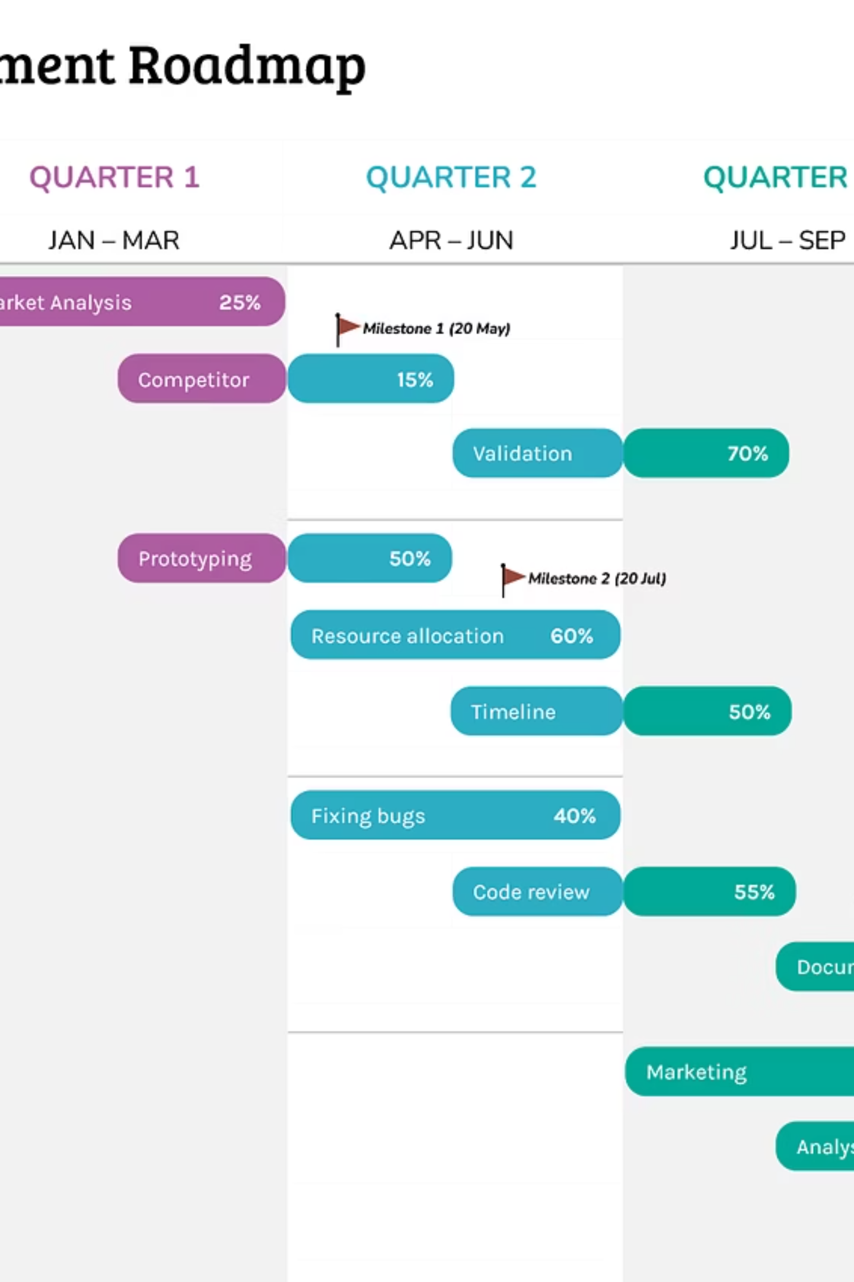
Roadmap — 3 Phases to Scale
01
02
Phase 1 — Cold Storage (0–12 months)
Phase 2 — Compute at the Edge (12–24 months)
Deploy S3 Gateway, onboard CCTV & log customers, secure 200 racks across 6 Tier‑2 cities.
Introduce lightweight edge compute for analytics/retention policies and near‑camera processing.
03
Phase 3 — Global Data‑Center Mesh (24–48 months)
Expand mesh to regional partners, offer cross‑border sovereignty controls and hybrid-cloud interoperability.
CEO's Speaking Notes: Illustrate measurable milestones and unit economics per phase. Emphasize how Phase 1 funds Phase 2 with predictable ARR streams.

